Slide 1







Mans Squad
Together Always Bro

Slide 2
The Boys
Never serious, always legendary

Slide 3
Our Story
We met randomly, bonded over memes, late-night talks, and food cravings. From bench partners to best bros, our journey is filled with laughter, unplanned adventures, and brotherhood that keeps us strong through anything life throws our way.

Slide 4

Problems
Getting scolded was routine.
Late arrivals, bunking, and chaos always followed us everywhere.

Slide 5
Goals
Stay real
Make the craziest memories while standing by each other no matter what.

Slide 6

Vibes
From shouting across corridors to deep 2 AM talks, our friendship is chaos, comfort, and everything in between—defined by laughter, madness, and real brotherhood.

Slide 7
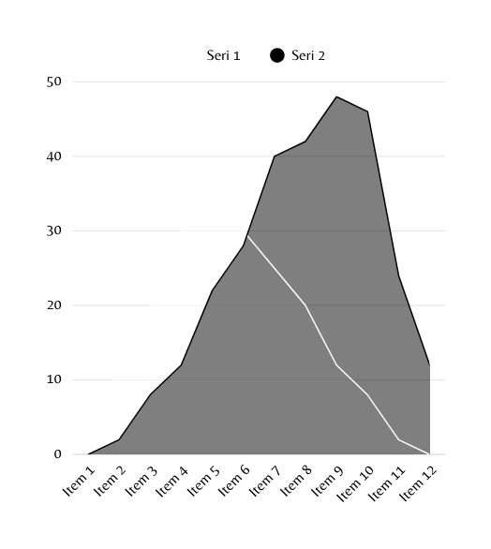
Data Analysis
Our daily routine: roast, chill, repeat. Data says 90% of the time we're laughing. Remaining 10%? Planning more chaos. Every moment together adds to our crazy stats.

Slide 8
Result
Became legends.
Turned boredom into chaos.
Created memories we’ll never forget.

Slide 9

Conclusion
Life’s better with the Mans. It's not just friendship, it's a full-time commitment to laughter, loyalty, and limitless memories.

Slide 10



Highlights
Epic jokes, dumb plans, and inside jokes that nobody else gets.

Slide 11
Any story you can’t forget?

Slide 12
Mans 4ever

